Slide 1
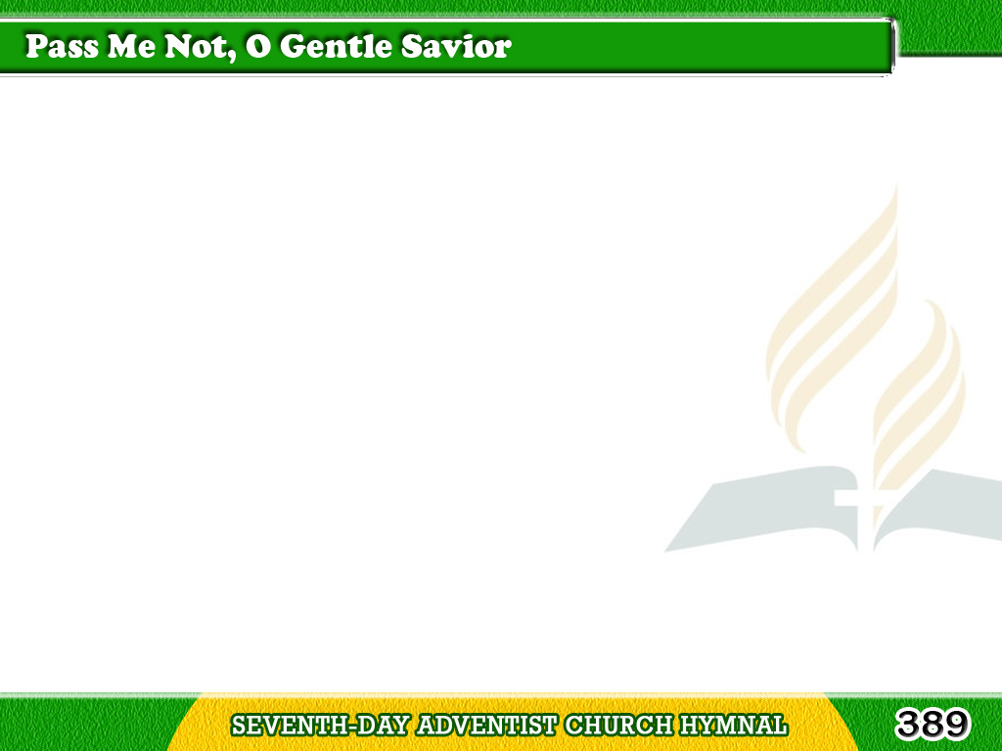
1/4
Pass me not, O gentle Savior,
Hear my humble cry;
While on others Thou art calling,
Do not pass me by.
Tagalog
Version

Slide 2
1/4
Chorus
Savior, Savior,
hear my humble cry,
While on others Thou art calling,
Do not pass me by.
Tagalog
Version

Slide 3
2/4
Let me at Thy throne of mercy
Find a sweet relief;
Kneeling there deep contrition,
Help my unbelief.
Tagalog
Version

Slide 4
2/4
Chorus
Savior, Savior,
hear my humble cry,
While on others Thou art calling,
Do not pass me by.
Tagalog
Version

Slide 5
3/4
Trusting only in Thy merit,
Would I seek Thy face;
Heal my wounded, broken spirit,
Save me by Thy grace.
Tagalog
Version

Slide 6
3/4
Chorus
Savior, Savior,
hear my humble cry,
While on others Thou art calling,
Do not pass me by.
Tagalog
Version

Slide 7
4/4
Thou the spring of all my comfort,
More than life for me;
Whom have I
on earth beside Thee?
Whom in heaven but Thee?
Tagalog
Version

Slide 8
4/4
Chorus
Savior, Savior,
hear my humble cry,
While on others Thou art calling,
Do not pass me by.
Tagalog
Version

